Slide 1
10 Upcoming Technologies
Contents:
Iot (Internet of Things)
Artificial Intelligence (AI)
5G
Serverless computing
Blockchain
Robotics
Biometrics
3D printing
Virtual reality (VR)/Augmented reality (AR)
Drones

Slide 2
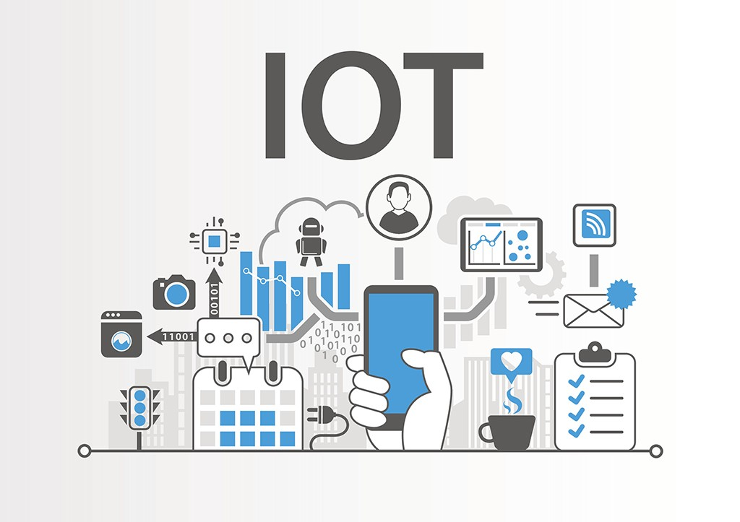
1. IoT(Internet Of Things)
IoT is driving business changes by providing the data needed to improve marketing, increase sales, and decrease costs, the report found.
"Everybody in the technology world, as well as many consumers, is hearing the term Internet of Things," Frank Raimondi, a member of the CompTIA Emerging Technology Community leadership group who works in strategic channel and business development for Chargifi, said in a press release.

Slide 3

2. Artificial Intelligence (AI)
AI is already significantly impacting the way customers interact with businesses via intelligent websites and bots, and these tools are becoming increasingly commoditized and integrated into daily work, the report noted.
"The largest impacts across all industries—from retail to healthcare, hospitality to finance—are felt when AI improves data security, decision-making speed and accuracy, and employee output and training," Maddy Martin, community vice chair and head of growth and education for Smith.ai, said in the release.

Slide 4

3. 5G
The rise of 5G Network is increasing our ability to move, manipulate, and analyze data across wireless platforms, according to CompTIA. As 5G rolls out more fully in the coming years, it will drive the development of more complex apps to solve problems and increase growth across industries.
"The development and deployment of 5G is going to enable business impact at a level few technologies ever have, providing wireless at the speed and latency needed for complex solutions like driverless vehicles," Michael Haines, community chair and director of partner incentive strategy and program design for Microsoft, said in the release.

Slide 5
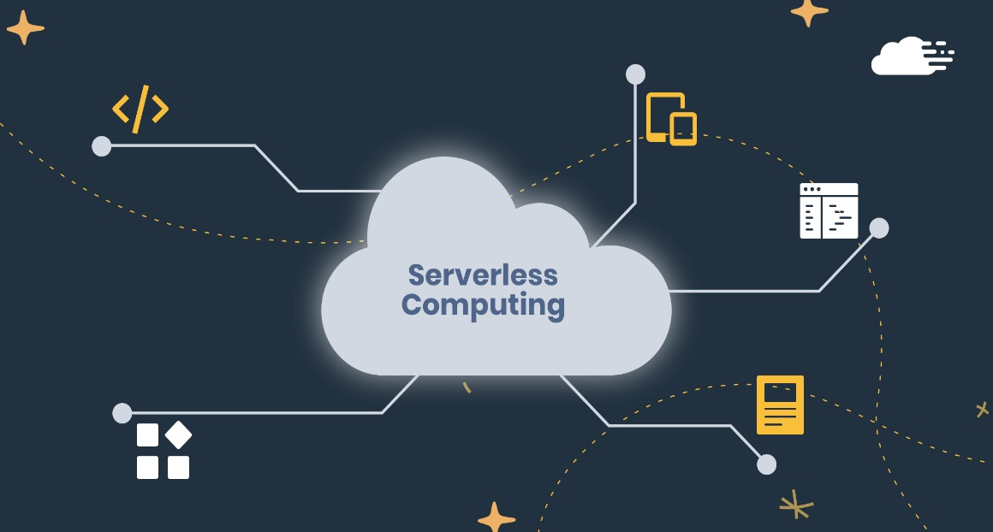
4. Serverless computing
Serverless computing allows organizations to create a NoOps IT environment that is automated and abstracted from underlying infrastructure, reducing operational costs and allowing businesses to invest in developing new capabilities that add more value, the report found.
Serverless computing was new on the list this year, along with robotics, replaced quantum computing, and automation, CompTIA noted.

Slide 6
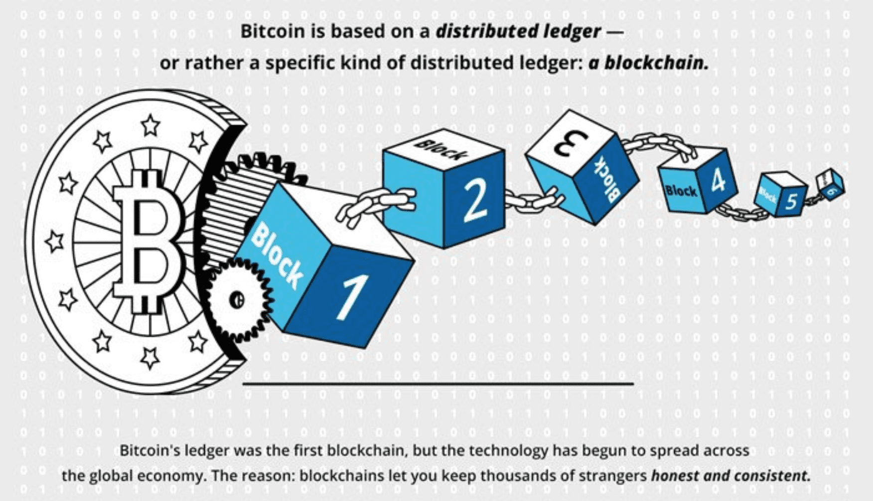
5. Blockchain
More organizations are exploring and implementing blockchain to solve the increased need to secure and manage transactions across the internet.
"Blockchain came down crushing from its peak of hype cycle, and that's probably for the best," said Julia Moiseeva, a member of the community's leadership group and founder of CLaaS (C-Level as a Service) Management Solutions Ltd, in the release. "Now that the luster of novelty and furor of the masses are gone, the dynamic of work around blockchain took a complete U-turn, again, for the best."

Slide 7
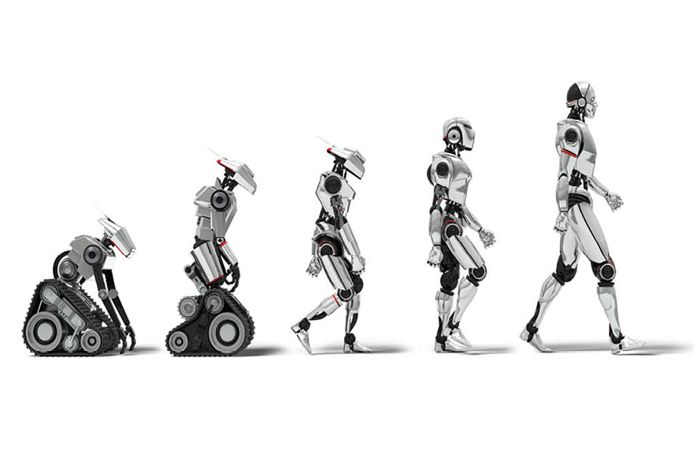
6. Robotics
Robotics is automating routine processes by using machines to make businesses faster, less expensive, and more efficient, the report found.

Slide 8
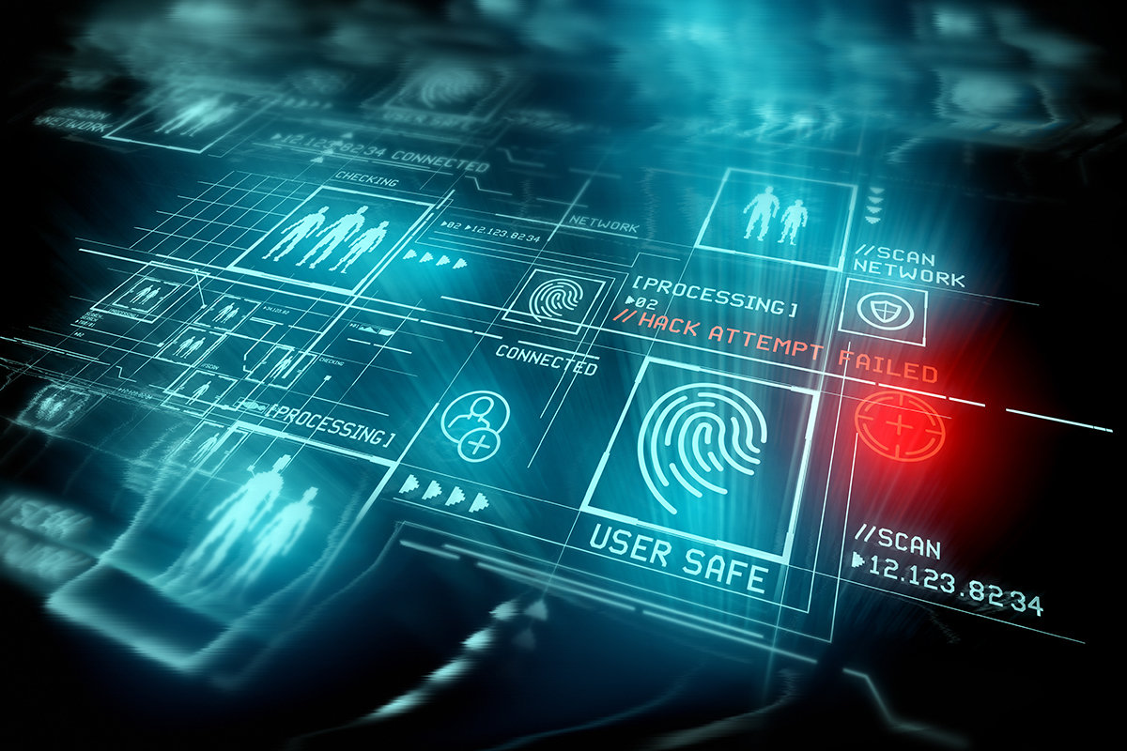

7. Biometrics
Biometrics—including face, fingerprint, and retina scans—are becoming mainstream methods for verifying identity. These methods will form the secure foundation for solutions delivered by IT companies moving forward, CompTIA said.

Slide 9
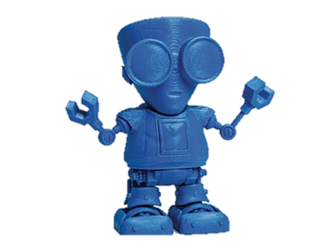

8. 3D printing
3D printing offers a solution for the low volume manufacturing of complex parts, as well as fast local production of difficult-to-find products, the report noted. As more affordable products become available, opportunities for this industry will continue to grow, it added.

Slide 10
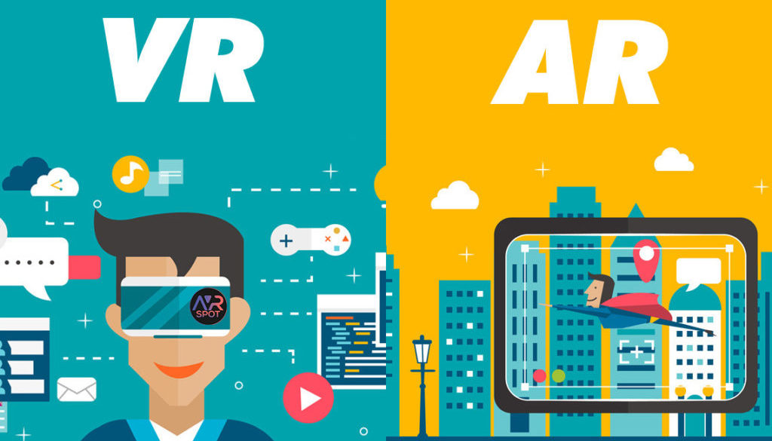
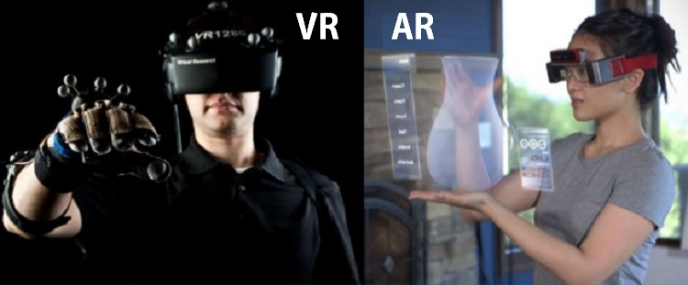
9. Virtual reality (VR)/Augmented reality (AR)
Using VR, AR, mixed reality, AI, and sensor technologies can help organizations improve operational efficiency and individual productivity, according to the report.

Slide 11
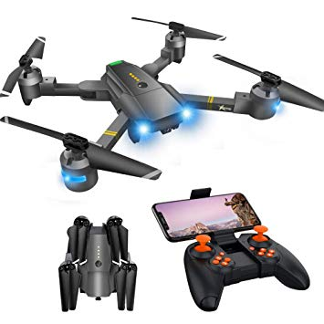
10. Drones
Drones enable robotic automation with fewer geographical restrictions, the report noted. Opportunities for development and integration are high for this market, it added.

